Slide 1
Biological Neuron - McCulloch Pitts Neuron
Prakash P VIT , Chennai

Slide 2
Road Map
Fundamental unit of a deep neural network
Biological Neuron
McCulloch Pitts Neuron
Thresholding Logic

Slide 3
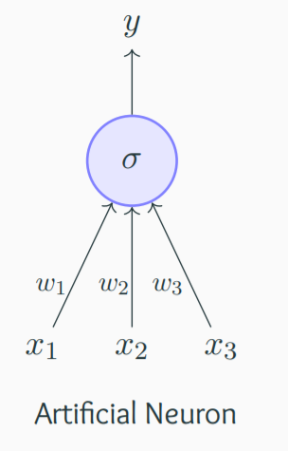
Artificial Neuron
The most fundamental unit of a deep neural network is called an artificial neuron
Why is it called a neuron ? Where does the inspiration come from ?
The inspiration comes from biology (more specifically, from the brain)
biological neurons = neural cells = neural processing units
Biological Neurons

Slide 4
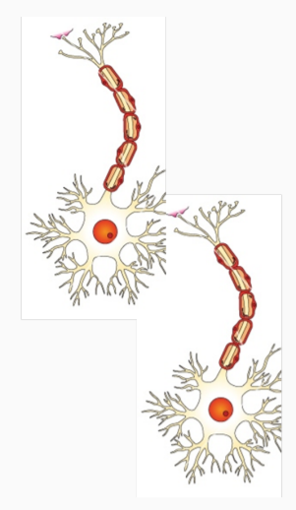
Artificial Neurons vs Biological Neurons

Slide 5
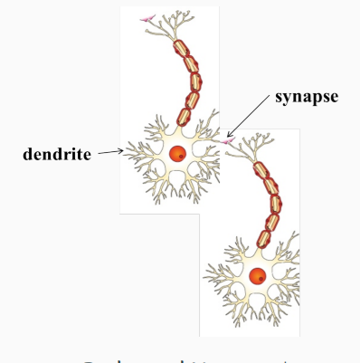
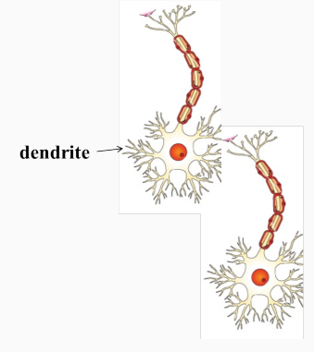
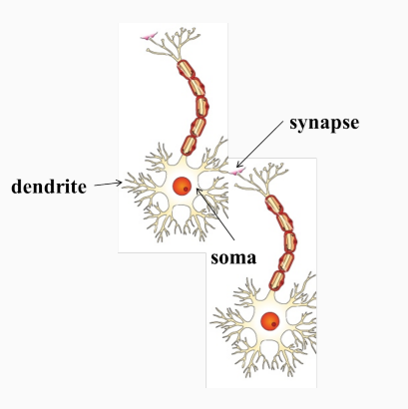
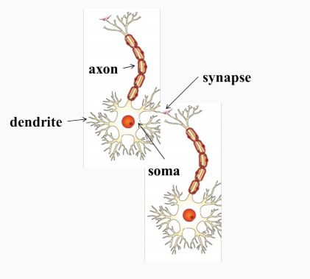
Artificial Neurons vs Biological Neurons
dendrite: receives signals from other neurons
synapse: point of connection to other neurons
soma: processes the information
axon: transmits the output of this
neuron

Slide 6

Cartoonish illustration - neuron works
Our sense organs interact with the outside world

Slide 7
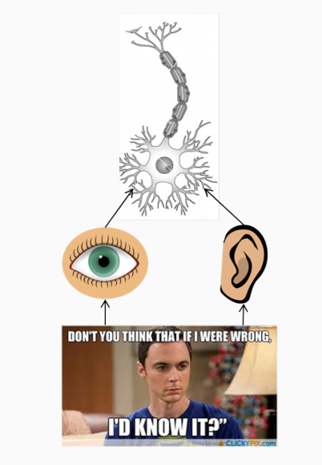
Cartoonish illustration - neuron works
Our sense organs interact with the outside world
They relay information to the neurons

Slide 8

Cartoonish illustration - neuron works
Our sense organs interact with the outside world
They relay information to the neurons
The neurons (may) get activated and produces a response

Slide 9
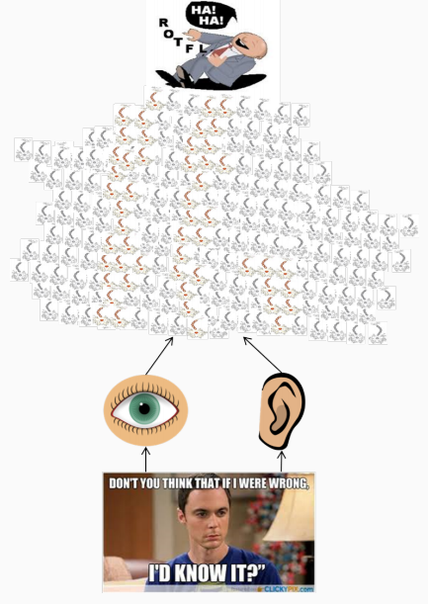
Cartoonish illustration - neuron works
Of course, in reality, it is not just a single neuron which does all this
There is a massively parallel interconnected network of neurons
The sense organs relay information to the lowest layer of neurons
Some of these neurons may fire (in red) in response to this information and in turn relay information to other neurons they are connected to
These neurons may also fire (again, in red) and
the process continues eventually resulting in a response (laughter in this case)
An average human brain has around 10¹¹ (100 billion) neurons!

Slide 10




Cartoonish illustration - neuron works
This massively parallel network also ensures that there is division of work
Each neuron may perform a certain role or respond to a certain stimulus

Slide 11
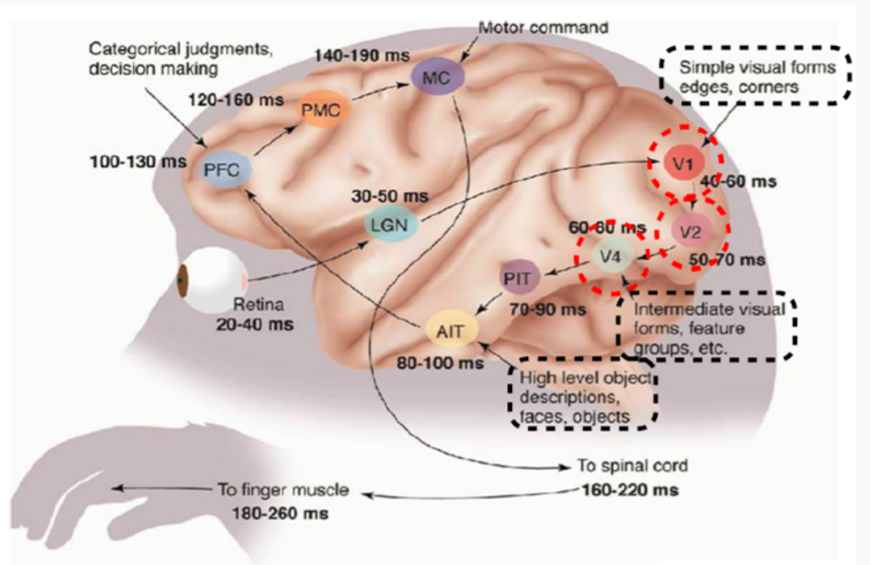

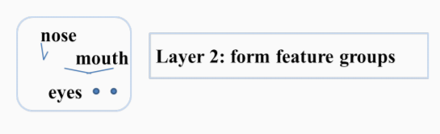
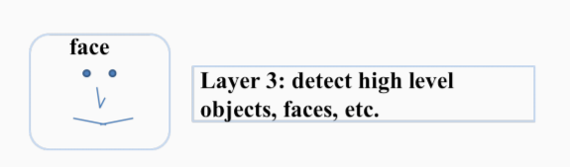
Simple illustration - processing visual information
observe that the layers V₁, V₂ to AIT form a hierarchy (from identifying simple visual forms to high level objects)
The neurons in the brain are arranged in a hierarchy

Slide 12
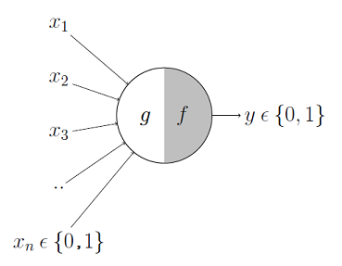
McCulloch Pitts Neuron
The first computational model of a neuron was proposed by Warren MuCulloch (neuroscientist) and Walter Pitts (logician) in 1943
It may be divided into 2 parts.
The first part, g takes an input (ahem dendrite ahem), performs an aggregation
Based on the aggregated value the second part, f makes a decision

Slide 13
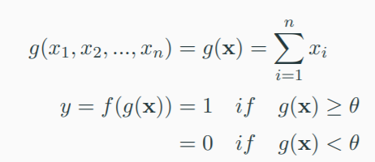
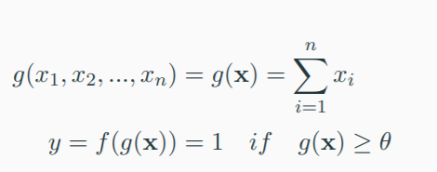
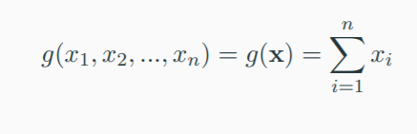
McCulloch Pitts Neuron
The inputs can be excitatory or inhibitory
y = 0 if any x_{i} is inhibitory , else (excitatory)
θ is called the thresholding parameter
This is called Thresholding Logic

Slide 14
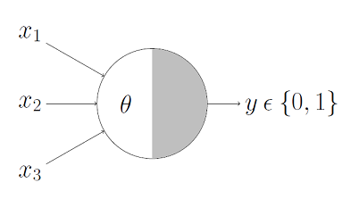
Boolean Functions Using M-P Neuron
This representation just denotes that, for the boolean inputs x_1, x_2 and x_3 if the g(x)
i.e., sum ≥ theta, the neuron will fire otherwise, it won’t

Slide 15
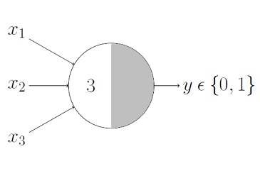
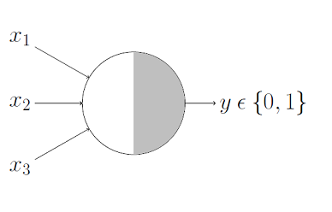
Boolean Functions Using M-P Neuron
An _____________neuron would only fire when ALL the inputs are ON i.e., g(x) ≥ 3 here

Slide 16
Boolean Functions Using M-P Neuron
An AND function neuron would only fire when ALL the inputs are ON i.e., g(x) ≥ 3 here

Slide 17

Boolean Functions Using M-P Neuron
An ___________neuron would fire if ANY of the inputs is ON i.e., g(x) ≥ 1 here

Slide 18
Boolean Functions Using M-P Neuron
An OR function neuron would fire if ANY of the inputs is ON i.e., g(x) ≥ 1 here

Slide 19
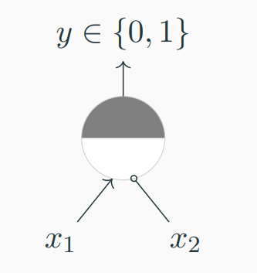
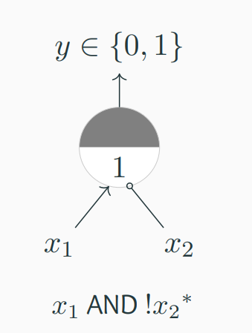
Boolean Functions Using M-P Neuron
∗ circle at the end indicates inhibitory input: if any inhibitory input is 1 the output will be 0

Slide 20
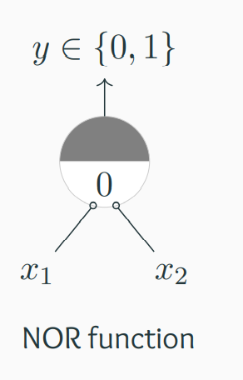
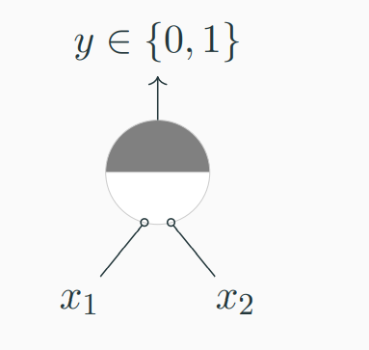
Boolean Functions Using M-P Neuron
Circle at the end indicates inhibitory input: if any inhibitory input is 1 the output will be 0

Slide 21
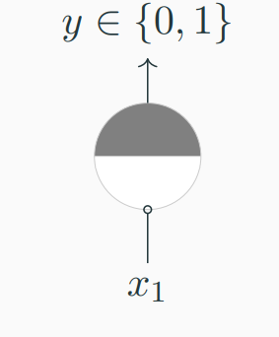
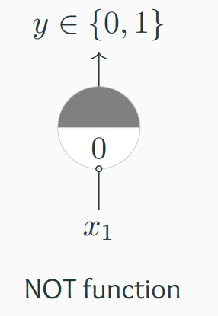
Boolean Functions Using M-P Neuron
Circle at the end indicates inhibitory input: if any inhibitory input is 1 the output will be 0

Slide 22
Boolean Functions Using M-P Neuron
Can any boolean function be represented using a McCulloch Pitts unit ?

Slide 23
References
https://towardsdatascience.com/mcculloch-pitts-model-5fdf65ac5dd1
https://www.cse.iitm.ac.in/~miteshk/CS6910.html#schedule

Slide 24
Thanks

